Slide 1


Healthcare Website
Mini project
Technology used:
HTML,CSS,BOOTSTRAP
References:
Professor Amit Goel
Professor Tarun Kumar Sharma
Submitted By:
Bilal Saifi

Slide 2

A way to
Get you Fit

Slide 3

Sehat Era is a Healthcare website
Health care is the improvement
of health via the prevention, diagnosis,
Treatment or cure of disease,
illness, injury, and other physical and mental
impairments in people. Health care is delivered by
health professionals and allied health fields
The vision of Sehat Era is to Get you fit.

Slide 4

The main objective of Sehat Era is to promote healthy living and to facilitate prevention, early detection and management
of non-communicable diseases.
To ensure provision of state-of-the-art
Emergency Care Services, including medical,
surgical (especially Trauma and Burn Care),
pediatric and obstetric emergency care for all

Slide 5
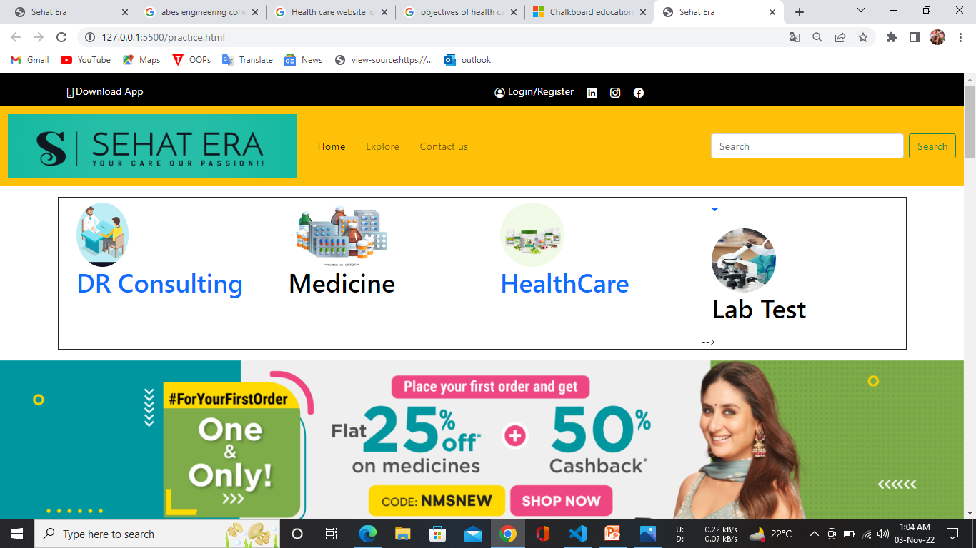

Slide 6
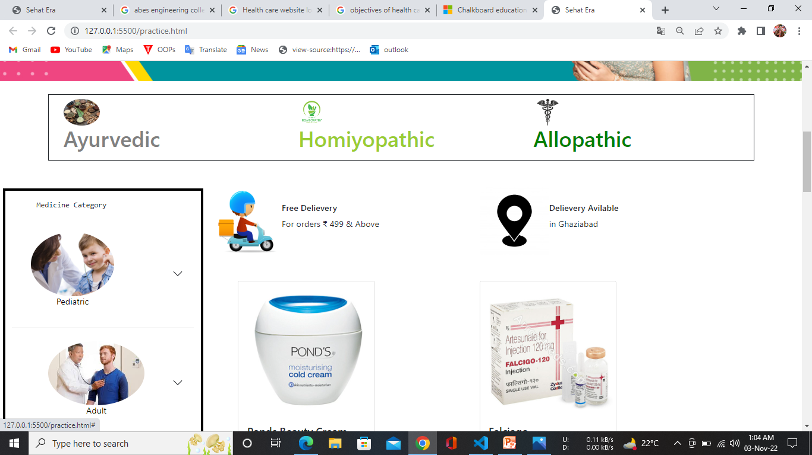

Slide 7
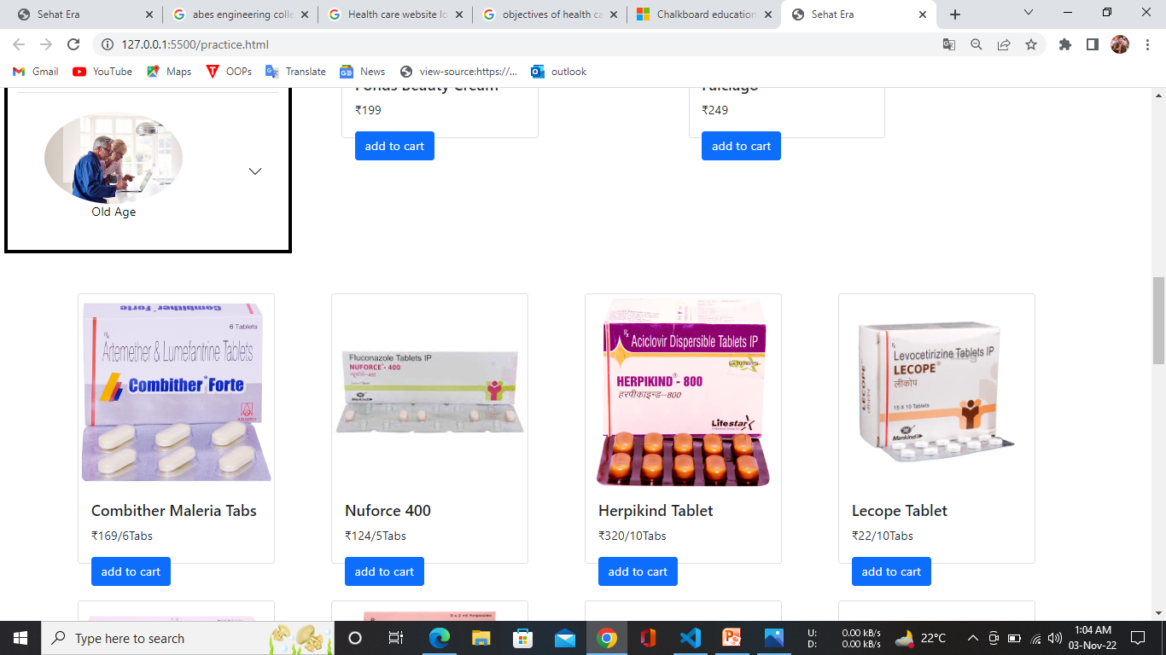

Slide 8
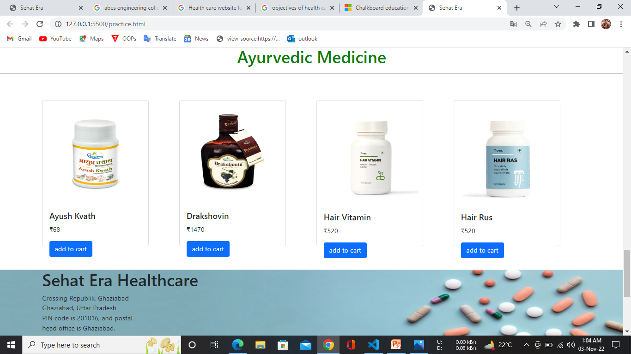

Slide 9
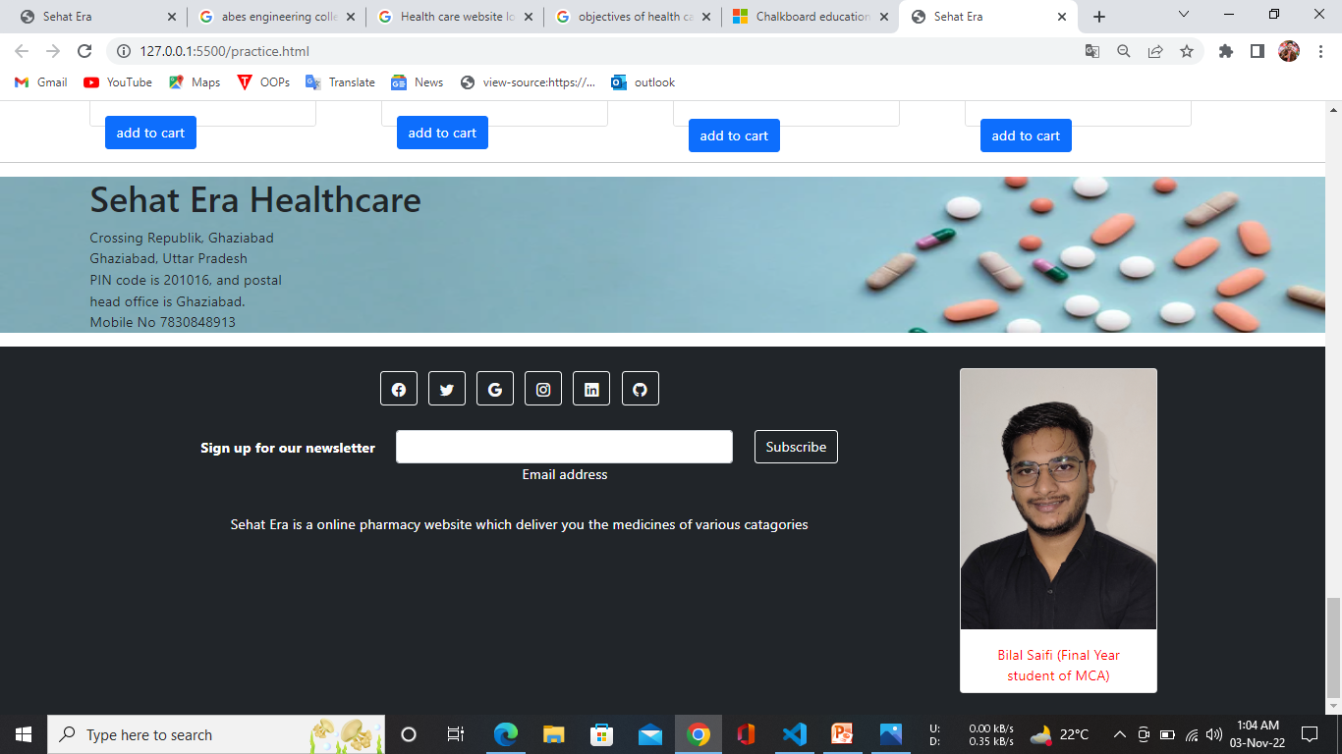

Slide 10
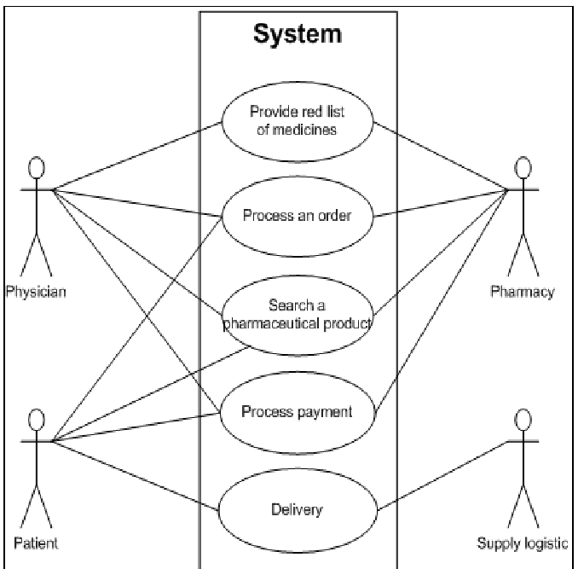
Use case diagram

Slide 11
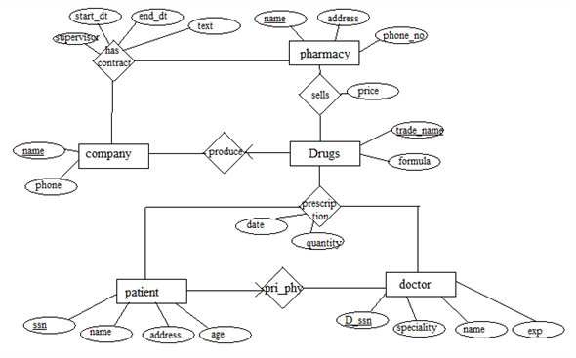
ER Diagram

Slide 12
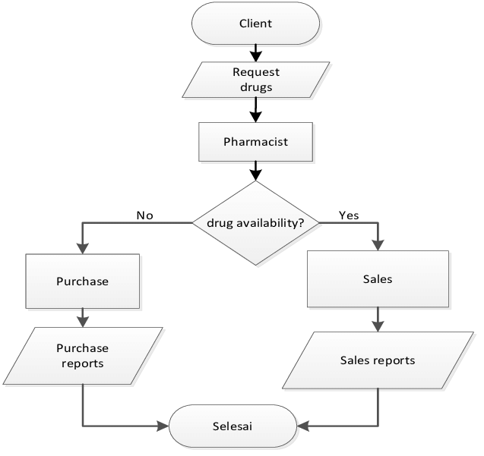
Data Flow Diagram

Slide 13


